Slide 1
Merge Sort https://www.cs.uiowa.edu/~hzhang/c31/notes/mergesort.ppt

Slide 2
Merging
The key to Merge Sort is merging two sorted lists into one, such that if you have two lists X (x₁≤x₂≤…≤x_{m}) and Y(y₁≤y₂≤…≤y_{n}) the resulting list is Z(z₁≤z₂≤…≤z_{m+n})
Example:
L₁ = { 3 8 9 } L₂ = { 1 5 7 }
merge(L₁, L₂) = { 1 3 5 7 8 9 }

Slide 3
Merging (cont.)
X:
3 | 10 | 23 | 54
Y:
1 | 5 | 25 | 75
Result:

Slide 4
Merging (cont.)
X:
3 | 10 | 23 | 54
Y:
 | 5 | 25 | 75
Result:
1

Slide 5
Merging (cont.)
X:
 | 10 | 23 | 54
Y:
 | 5 | 25 | 75
Result:
1 | 3

Slide 6
Merging (cont.)
X:
 | 10 | 23 | 54
Y:
 |  | 25 | 75
Result:
1 | 3 | 5

Slide 7
Merging (cont.)
X:
 |  | 23 | 54
Y:
 |  | 25 | 75
Result:
1 | 3 | 5 | 10

Slide 8
Merging (cont.)
X:
 |  |  | 54
Y:
 |  | 25 | 75
Result:
1 | 3 | 5 | 10 | 23

Slide 9
Merging (cont.)
X:
 |  |  | 54
Y:
 |  |  | 75
Result:
1 | 3 | 5 | 10 | 23 | 25

Slide 10
Merging (cont.)
X:
Y:
 |  |  | 75
Result:
1 | 3 | 5 | 10 | 23 | 25 | 54

Slide 11
Merging (cont.)
X:
Y:
Result:
1 | 3 | 5 | 10 | 23 | 25 | 54 | 75

Slide 12
Divide And Conquer
Merging a two lists of one element each is the same as sorting them.
Merge sort divides up an unsorted list until the above condition is met and then sorts the divided parts back together in pairs.
Specifically this can be done by recursively dividing the unsorted list in half, merge sorting the right side then the left side and then merging the right and left back together.

Slide 13
Merge Sort Algorithm
Given a list L with a length k:
If k == 1 → the list is sorted
Else:
  Merge Sort the left side (1 thru k/2)
  Merge Sort the right side (k/2+1 thru k)
  Merge the right side with the left side

Slide 14
Merge Sort Example
99 | 6 | 86 | 15 | 58 | 35 | 86 | 4 | 0

Slide 15
Merge Sort Example
99 | 6 | 86 | 15 | 58 | 35 | 86 | 4 | 0
99 | 6 | 86 | 15
58 | 35 | 86 | 4 | 0

Slide 16
Merge Sort Example
99 | 6 | 86 | 15 | 58 | 35 | 86 | 4 | 0
99 | 6 | 86 | 15
58 | 35 | 86 | 4 | 0
99 | 6
86 | 15
58 | 35
86 | 4 | 0

Slide 17
Merge Sort Example
99 | 6 | 86 | 15 | 58 | 35 | 86 | 4 | 0
99 | 6 | 86 | 15
58 | 35 | 86 | 4 | 0
99 | 6
86 | 15
58 | 35
86 | 4 | 0
99
6
86
15
58
35
86
4 | 0

Slide 18
Merge Sort Example
99 | 6 | 86 | 15 | 58 | 35 | 86 | 4 | 0
99 | 6 | 86 | 15
58 | 35 | 86 | 4 | 0
99 | 6
86 | 15
58 | 35
86 | 4 | 0
99
6
86
15
58
35
86
4 | 0
4
0

Slide 19
Merge Sort Example
99
6
86
15
58
35
86
0 | 4
Merge
4
0

Slide 20
Merge Sort Example
6 | 99
15 | 86
58 | 35
0 | 4 | 86
99
6
86
15
58
35
86
0 | 4
Merge

Slide 21
Merge Sort Example
6 | 15 | 86 | 99
0 | 4 | 35 | 58 | 86
6 | 99
15 | 86
58 | 35
0 | 4 | 86
Merge

Slide 22
Merge Sort Example
0 | 4 | 6 | 15 | 35 | 58 | 86 | 86 | 99
6 | 15 | 86 | 99
0 | 4 | 35 | 58 | 86
Merge

Slide 23
Merge Sort Example
0 | 4 | 6 | 15 | 35 | 58 | 86 | 86 | 99

Slide 24
Implementing Merge Sort
There are two basic ways to implement merge sort:
  In Place: Merging is done with only the input array
    Pro: Requires only the space needed to hold the array
    Con: Takes longer to merge because if the next element is in the right side then all of the elements must be moved down.
  Double Storage: Merging is done with a temporary array of the same size as the input array.
    Pro: Faster than In Place since the temp array holds the resulting array until both left and right sides are merged into the temp array, then the temp array is appended over the input array.
    Con: The memory requirement is doubled.

Slide 25
mergeSort(arr, int left, int right)
{ if (left >= right) return; int mid = (left + right) / 2; mergeSort(arr, left, mid); mergeSort(arr, mid + 1, right); merge(arr, left, mid, right);
}
Merge(arr, beg, mid, end)
{
int start1=beg, start2=mid+1,pos=0;
while(start1<=mid && start2<=end)
{
if(arr[start1]<=arr[start2])
{arr_temp[pos++]=arr[start1]; start1++;}
else
{arr_temp[pos++]=arr[start2]; start2++;}
}
if (start1>mid)
while(start2<=end)
{arr_temp[pos++]=arr[start2++];}
if(start2>end)
while(start1<=mid)
{arr_temp[pos++]=arr[start1++];}
copy arr_temp to arr(beg, end)
}
HW: Check if logic works

Slide 26
Merge Sort Analysis
The Double Memory Merge Sort runs O (N log N) for all cases, because of its Divide and Conquer approach.
T(N) = 2T(N/2) + N = O(N logN)

Slide 27
Merge sort
MergeSort(arr[], l, r) If r > l
1. Find the middle point to divide the array into two halves:
middle m = (l+r)/2
2. Call mergeSort for first half:
Call mergeSort(arr, l, m)
3. Call mergeSort for second half:
Call mergeSort(arr, m+1, r)
4. Merge the two halves sorted in step 2 and 3:
Call merge(arr, l, m, r)
Recurrence equation:
c₁ if n=1
T(n) = 2T(n/2) + c.n if n>1

Slide 28
Recursion tree
Solve T(n) = 2T(n/2) + cn, where c > 0 is constant.
cn
cn
cn/2
cn/2
cn
h = lg n
cn/4
cn/4
cn/4
cn/4
cn
…
…
Θ(1)
#leaves = n
Θ(n)
Total = Θ(n lg n)
L1.<number>

Slide 29
Solution
By Substitution:
T(n) = 2T(n/2) + c₂n
T(n/2) = 2T(n/4) + c₂n/2
T(n) = 4T(n/4) + 2 c₂n
T(n) = 8T(n/8) + 3 c₂n
T(n) = 2^{i}T(n/2^{i}) + ic₂n
Assuming n = 2^{k}, expansion halts when we get T(1) on right side; this happens when i=k T(n) = 2^{k}T(1) + kc₂n
Since 2^{k}=n, we know k=logn; since T(1) = c₁, we get
T(n) = c₁n + c₂nlogn;
thus an upper bound for T_{mergeSort}(n) is O(nlogn)

Slide 30
Assume that a merge sort algorithm in the worst case takes 30 seconds for an input of size 64. Which of the following most closely approximates the maximum input size of a problem that can be solved in 6 minutes? (GATE 2015)
256
512
1024
2048
Notes:
https://gateoverflow.in/89083/gate-cse-1989-question-9

Slide 31
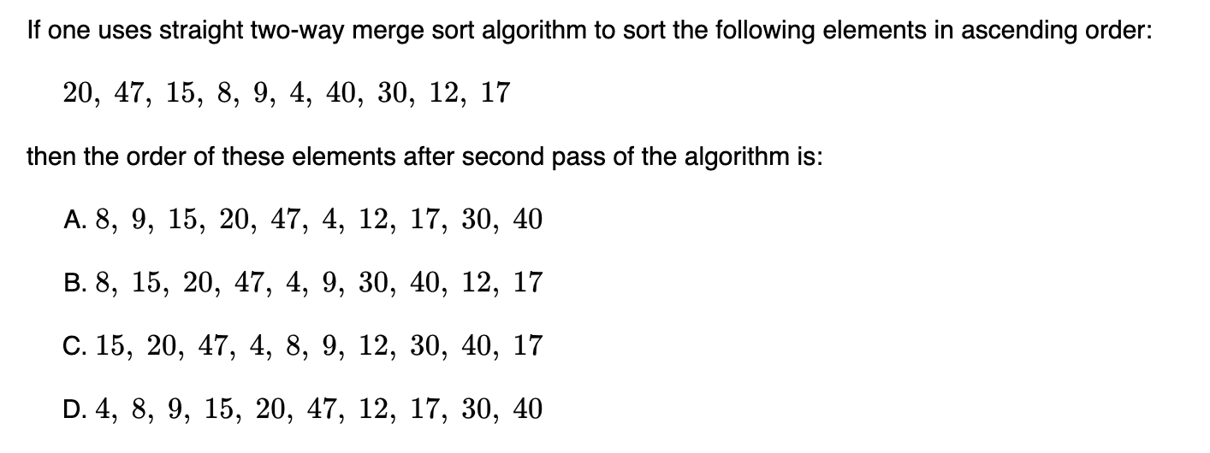
Notes:
https://gateoverflow.in/89083/gate-cse-1989-question-9

Slide 32
Finally…
There are other variants of Merge Sorts including k-way merge sorting, but the common variant is the Double Memory Merge Sort. Though the running time is O(N logN) and runs much faster than insertion sort and bubble sort, merge sort’s large memory demands makes it not very practical for main memory sorting.

Slide 33
Questions
H.W
If we partition into three(or k) parts instead of two, what would be the complexity of the algorithm ? What if we do a n-way merge sort ?
Would you prefer to use a three part merge sort –why or why not ?
What about a ternary search instead of binary search
Would you prefer 2-way merge sort to merge sort. Why or why not

